Slide 1


Towards Transparency in Black-Box Models: Investigating Methods in Explainability for AI Systems
Presenter: Saleh Alkhalifa, Senior Manager of Data Science

Slide 2

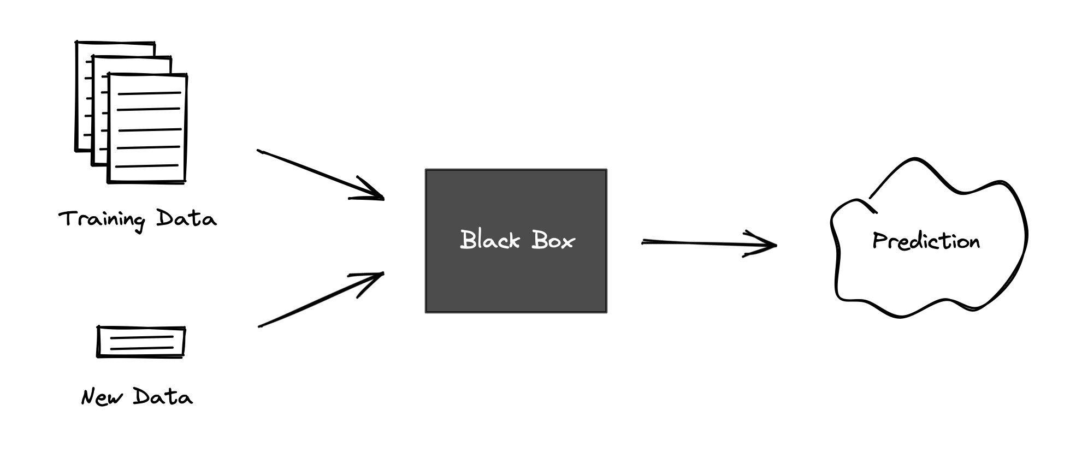
Introduction
Artificial Intelligence and Machine Learning models are increasingly deployed across critical domains, including pharmaceutical, healthcare, manufacturing, and finance, to automate complex decision-making processes.
Despite their often high accuracy, many AI/ML models operate as "black boxes," where the reasoning behind their predictions remains unclear, creating challenges in trust, reliability, and accountability with regulators
Explainability is crucial to bridge this gap by providing insights into model behavior, enabling developers and stakeholders to validate decisions, and ultimately ensure compliance with ethical and regulatory standards, and build trust in AI-driven systems

Slide 3
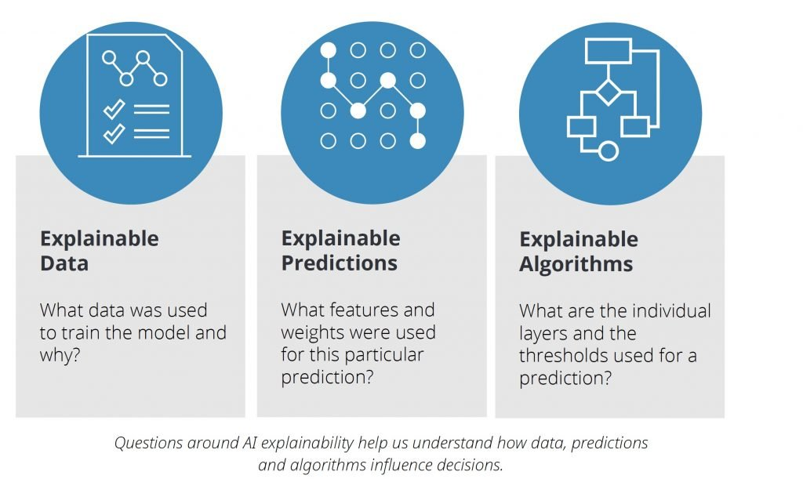
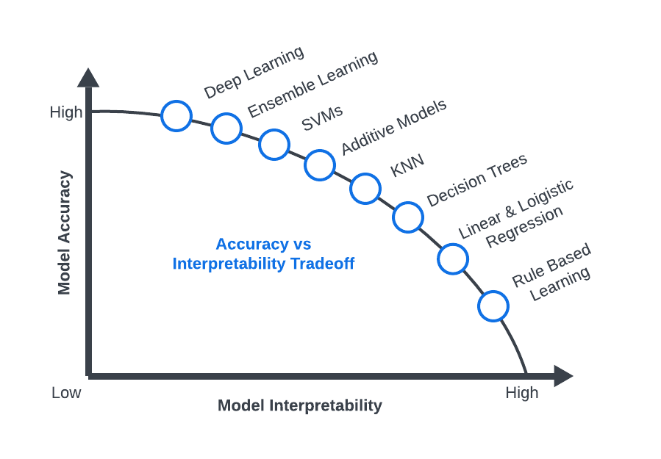
Approach & Methods
Explainability can be the focus on a few different areas of a given experiment, such as the input data, the weights and features, or even the algorithms
A diverse set of datasets (tabular, text, image), models (discriminative, generative, open-source, closed-source), and interpretability methods were selected.
Aim to highlight the balance between model accuracy and interpretability, tailoring model and method choices to specific tasks for optimal transparency and performance of the model

Slide 4
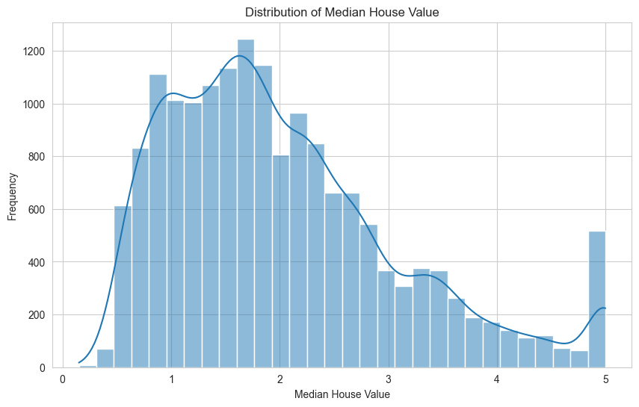
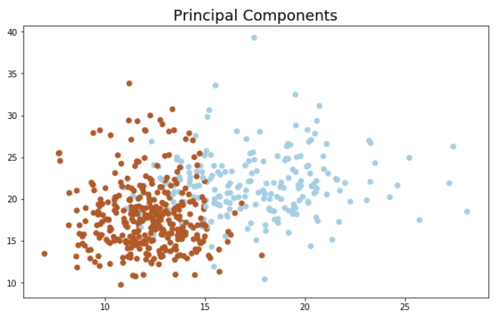
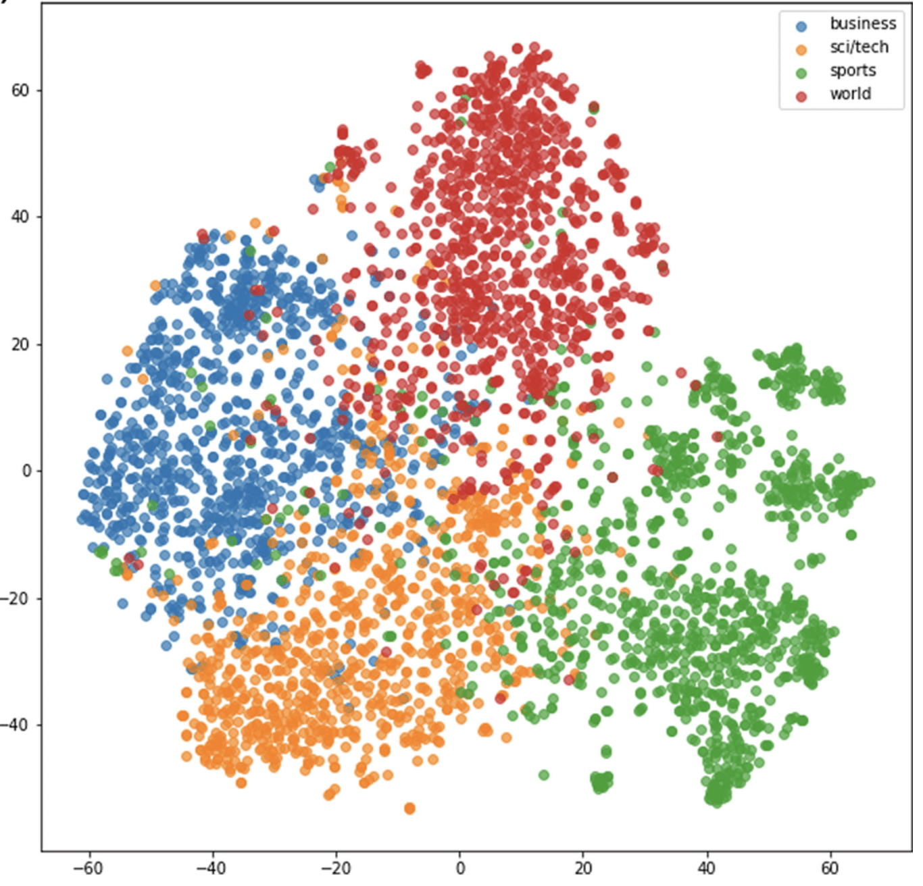
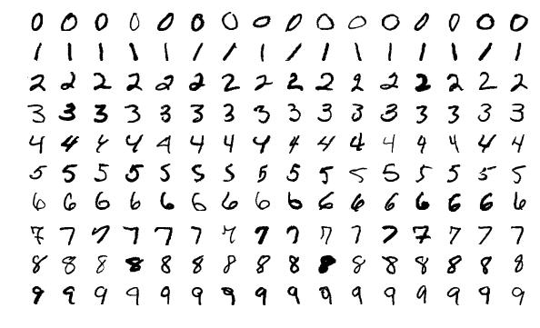
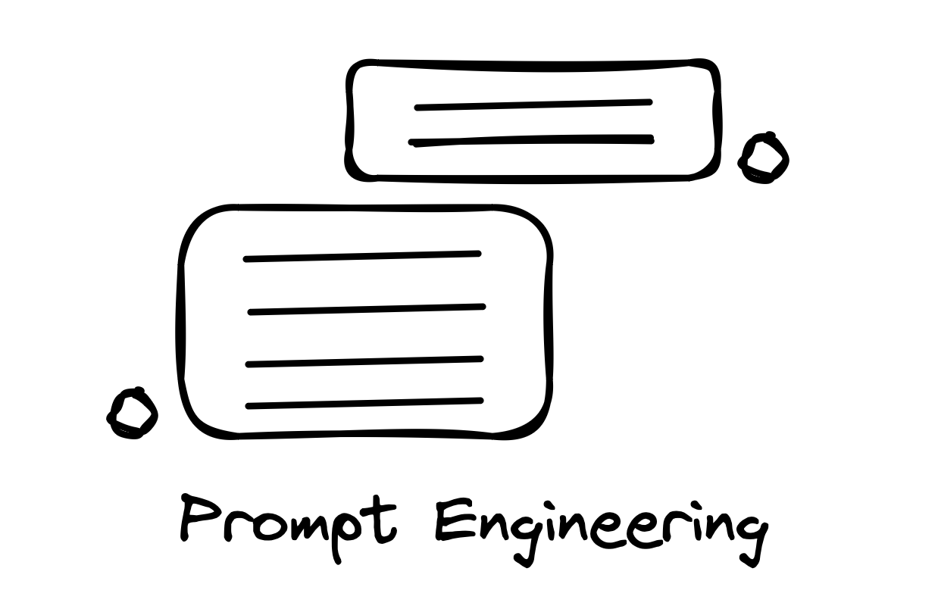
Data
California Housing
Wisconsin Breast Cancer
AG News
MNIST
Custom Prompts
First published in 1990
Regression Task
Tabular Data
16813 observations
9 features in total
Predict median value
First published in 1992
Classification Task
Tabular Data
569 observations
29 features in total
Predict diagnosis
First published in 2004
Classification Task
Textual Data
127000 observations
Max_Len is 64
Predict Category
First published in 1994
Classification Task
Image Data
60,000 observations
64 x 64 pixels
Predict Number
Custom Made
Classification Task
Text Data
10 observations
10-15 words
Prompt Engineering

Slide 5
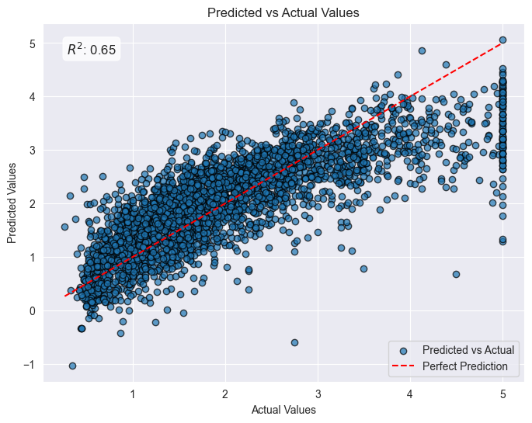
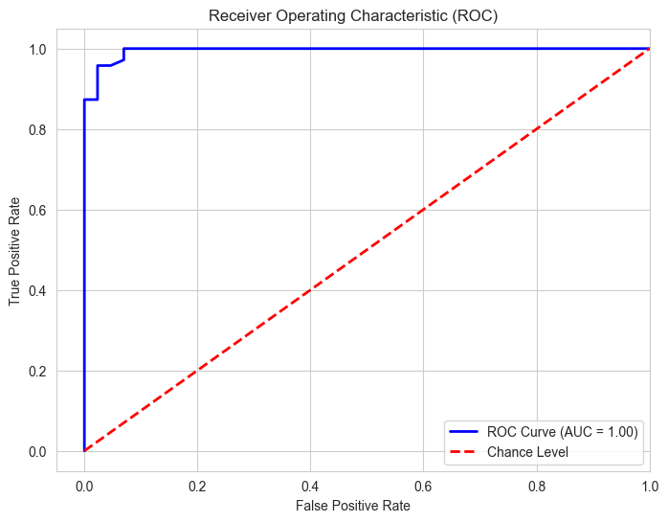
Models
California Housing
Wisconsin Breast Cancer
AG News
MNIST
Custom Prompts
Ridge Regression
Random Forest Classification
DistilBERT Language Model
Deep Learning
GPT-4o LLM
Linear Regression Model
L2 Regularization to reduce overfitting
Predict median house price
Feature weights available
Ensemble-Style Model
Combines multiple trees for robustness
Classify tumors as malignant of Benign
Feature importance metrics available
Transformer-based Model
Small-Medium language model
Classifying news articles
Contextual embeddings available
Feed-Forward Neural Network
Uses fully connected layers and ReLU
Classifies hand-written digits
Pixel-level contributions available
Closed-source Large Language model
Multi-modal language model
Sentiment Analysis for text
No access to weights, only input/output
Feature | Value
Training Loss | 0.44
Validation Loss | 0.38
Accuracy | 0.88

Slide 6
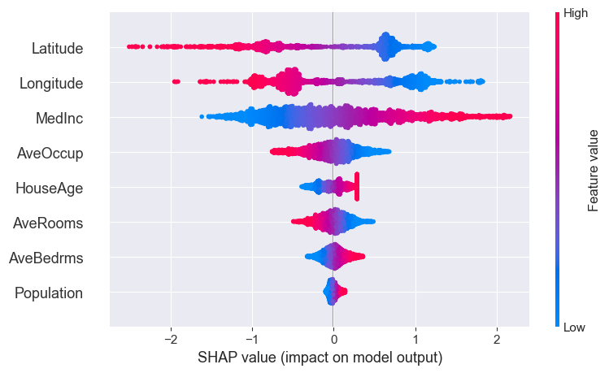
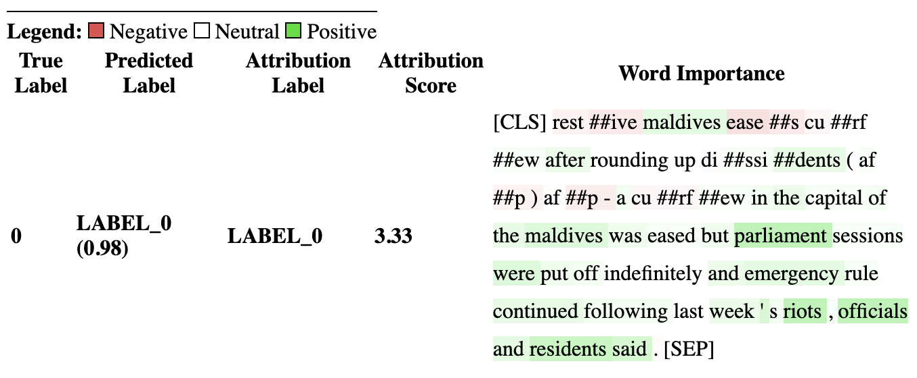
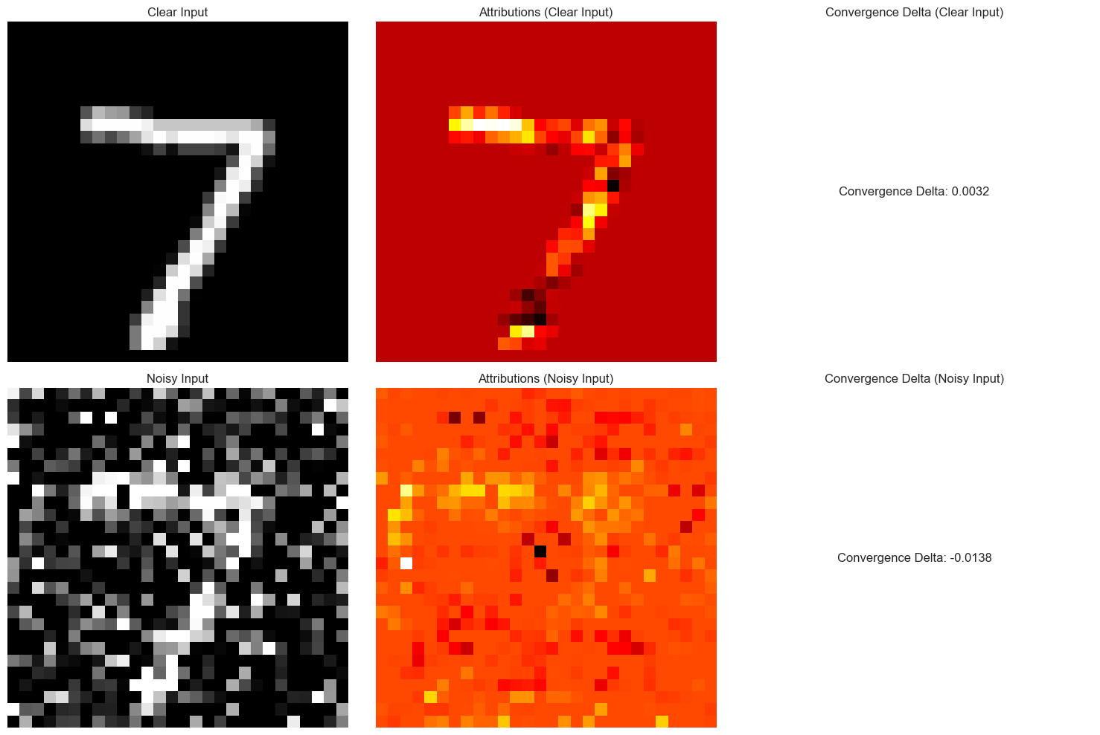
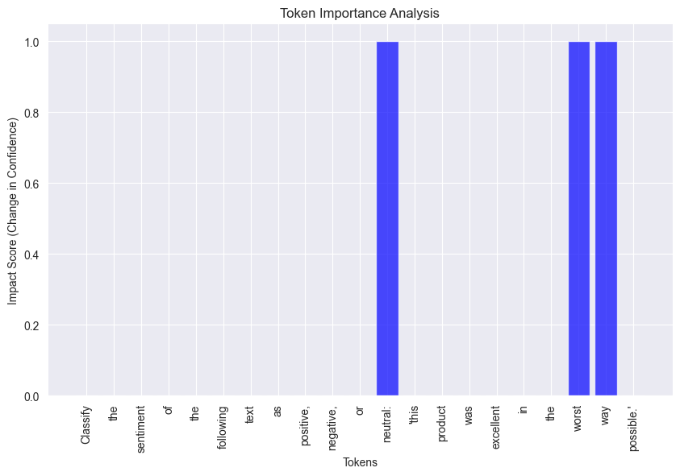
Explainability
California Housing
Wisconsin Breast Cancer
AG News
MNIST
Custom Prompts
Ridge Regression
Random Forest Classification
DistilBERT Language Model
Deep Learning
GPT-4o LLM
SHAP/LIME
Token-Level Attribution using
Integrated Gradients
Token-Level Importance
California (SHAP)
Cancer (LIME)
AG News (TLA)
MNIST (TLA)
Sentiment (TLI)
Feature | Value
Worst Area | -0.35
Worst Perimeter | -0.33
Worst Radius | -0.26
Mean Radius | -0.47
Worst Concavity | -0.04

Slide 7
Results
California Housing
Wisconsin Breast Cancer
AG News
MNIST
Custom Prompts
Ridge Regression
Random Forest Classification
DistilBERT Language Model
Deep Learning
GPT-4o LLM
SHAP/LIME
Token-Level Attribution using
Integrated Gradients
Token-Level Importance
SHAP highlighted the most impactful features (number of rooms, etc…) on housing price predictions, confirming global linear trends in the data.
LIME provided local explanations for specific predictions, enabling a clear view of how individual data points influenced the model's output (as we see previously)
SHAP offered a global understanding of feature importance, while LIME allowed for instance-specific analysis, helping identify potential outliers (as seen before)
Integrated Gradients revealed which tokens in AG News contributed most to classification decisions
TLA Identified tokens that overly influenced predictions helped pinpoint potential biases in the dataset or model
Integrated Gradients visualized the specific pixels in MNIST critical to recognizing digits, such as the horizontal and vertical strokes in "7" or "4” digits
Sensitivity Analysis was used by removing specific tokens from prompts and observing output changes quantified the importance of individual words or phrases in sentiment classification.
Prompt Optimization highlighted which parts of the input had the most significant impact

Slide 8

Conclusion
Explainability has become crucial as AI and ML models become increasingly integrated into critical decision-making processes, particularly in sensitive domains like pharmaceutical, healthcare, finance, and regulatory environments.
Different models and data types require tailored explainability approaches. For example, SHAP and LIME excel in structured datasets by providing both global and local insights, while Integrated Gradients shines in high-dimensional unstructured data like images and text.
Our study demonstrated that even highly complex or proprietary models like GPT-4o can benefit from targeted explainability techniques.
A key takeaway from our experiments is the tradeoff between model complexity and interpretability. While deep learning models like neural networks offer robust accuracy for tasks like digit classification, simpler models like Ridge Regression provide more transparent decision-making processes.

Slide 9
Future Work
Expand the number of datasets, models, and explainability methods and in different combinations so that we can better understand the entire landscape.
Implement models at different accuracy levels (low, medium, high) and investigate the impact this would have on explainability.
Investigate other areas such as video and audio to expand on the work done in this investigation.

Slide 10
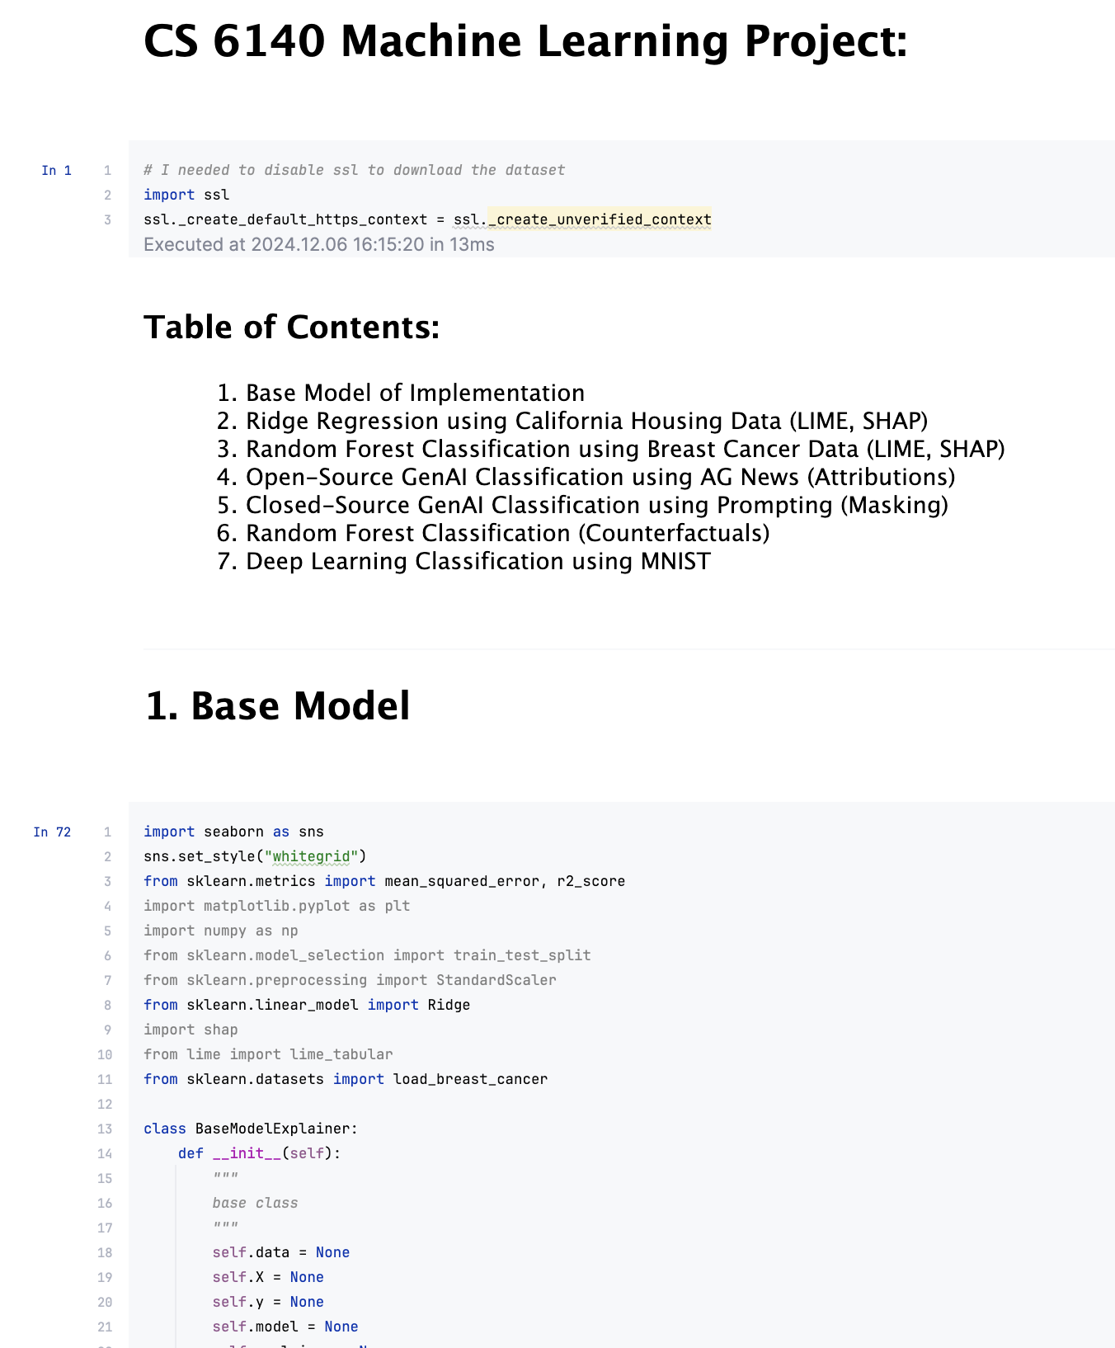
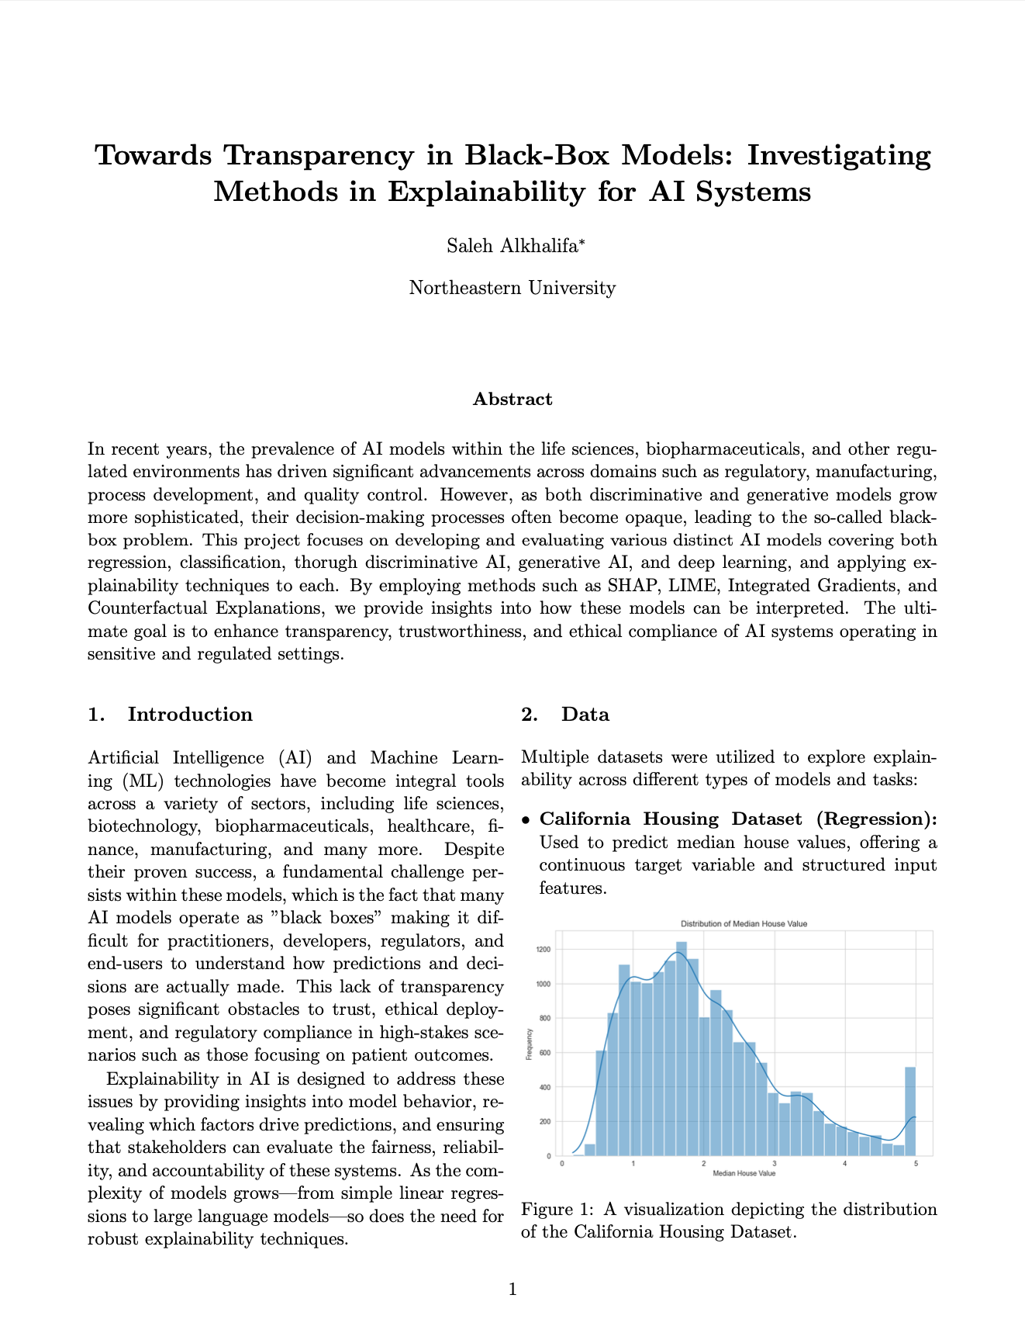
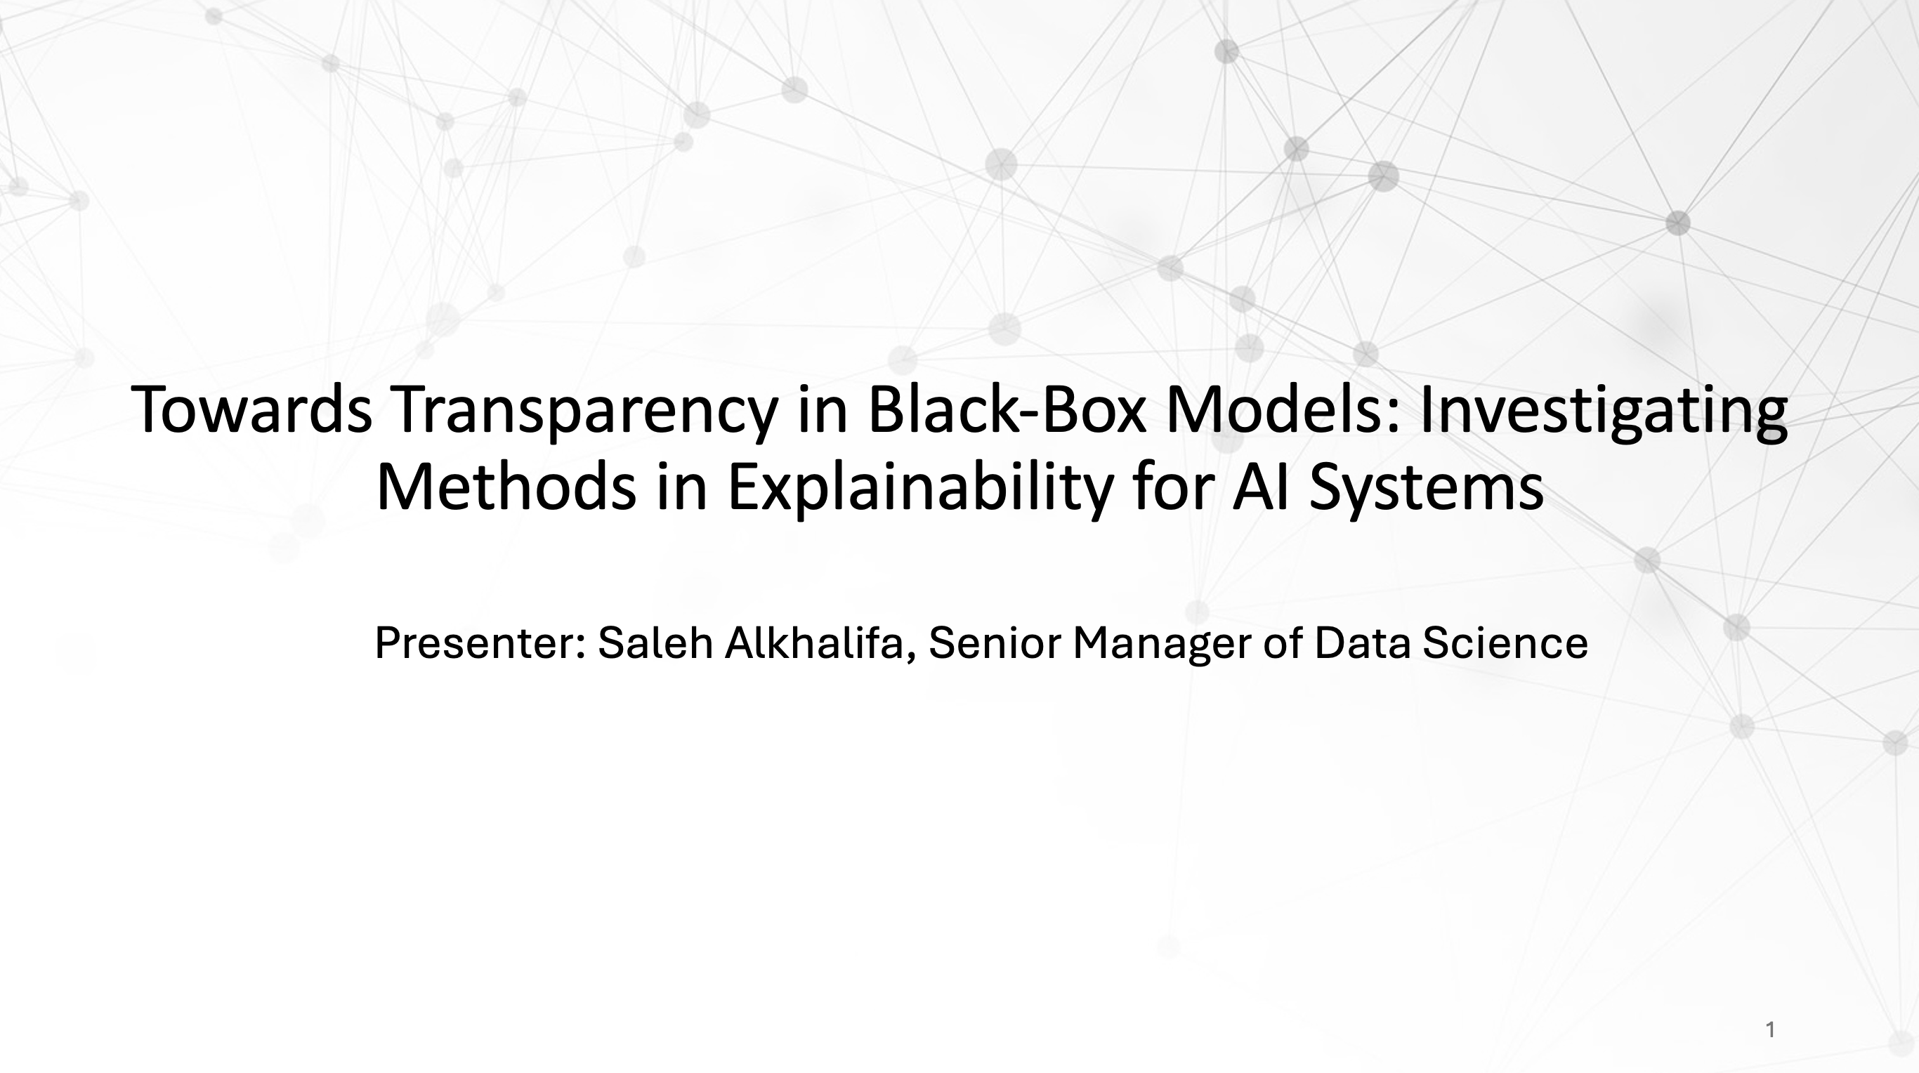
Deliverables
Full Codebase
Detailed Report
Summary Presentation

Slide 11
References
[1] Lundberg, S. M., & Lee, S.-I. (2017). A Uni- fied Approach to Interpreting Model Predic- tions. Advances in Neural Information Process- ing Systems.
[2] Ribeiro, M. T., Singh, S., & Guestrin, C. (2016). “Why Should I Trust You?”: Explaining the Predictions of Any Classifier. Proceedings of the 22nd ACM SIGKDD.
[3] Sundararajan, M., Taly, A., & Yan, Q. (2017). Axiomatic Attribution for Deep Networks. In- ternational Conference on Machine Learning (ICML).
[4] Kokhlikyan, N., et al. (2020). Captum: A Model Interpretability Library for PyTorch. arXiv preprint arXiv:2009.07896.
[5] Vig, J. (2019). A Multiscale Visualization of Attention in the Transformer Model. arXiv preprint arXiv:1906.05714.
[6] Mothilal, R. K., Sharma, A., & Tan, C. (2020). Explaining Machine Learning Classifiers,Proceedings of the 2020 Conference on Fairness, Accountability, and Transparency (FAT*20).
[7] Geada, R., et al. (2021). TrustyAI Explainabil- ity Toolkit. arXiv preprint arXiv:2104.12717.
[8] Lin, Z. Q., et al. (2019). Do Explanations Re- flect Decisions? A Machine-centric Strategy to Quantify the Performance of Explainability Al- gorithms. arXiv preprint arXiv:1910.07387.
[9] Salih, A. M., et al. (2023). A Perspective on Explainable Artificial Intelligence Methods: SHAP and LIME. Artificial Intelligence and Systems.
[10] Vimbi, V., Shaffi, N., & Mahmud, M. (2024). Interpreting Artificial Intelligence Models: A Systematic Review on the Application of LIME and SHAP in Alzheimer’s Disease Detection. Brain Informatics.
[11] Selvaraju, R. R., Cogswell, M., Das, A., et al. (2017). Grad-CAM: Visual Explanations from Deep Networks via Gradient-based Localiza- tion. Proceedings of the IEEE International Conference on Computer Vision (ICCV).
[12] Doshi-Velez, F., & Kim, B. (2017). Towards a Rigorous Science of Interpretable Machine Learning. arXiv preprint arXiv:1702.08608.
[13] Alvarez-Melis, D., & Jaakkola, T. S. (2018). Towards Robust Interpretability with Self- Explaining Neural Networks. Advances in Neu- ral Information Processing Systems (NeurIPS).

